Slide 1


PoE Product Training
Instructor Name

Slide 2

Topics
Introduction to PoE
TRENDnet PoE Products
802.3at or PoE+
802.3af standard PoE
Splitters/Injectors
IP Cameras
Wireless Access Points
Applications
TRENDnet Advantage
Questions

Slide 3

Introduction
What is Power over Ethernet (PoE)?
PoE technology describes any system that transmits electrical power, in addition to data, to remote devices over standard twisted-pair wire in an Ethernet network.

Slide 4

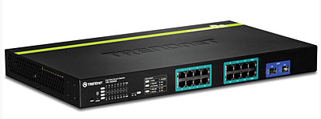



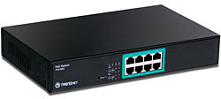
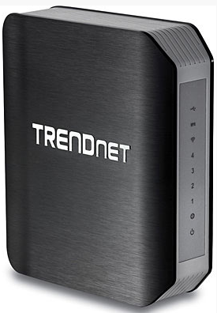
Introduction
How is Power over Ethernet (PoE) used?
PoE is useful for powering IP telephones, wireless LAN access points, IP cameras, and other low power network appliances where it would be inconvenient or infeasible to supply power separately.
Power + Data

Slide 5


Introduction
Features
Industry Standard
IEEE 802.3at = 34.2 watts (PoE+)
IEEE 802.3af = 15.4 watts (PoE)
Cabling
Cat 5,5e,or 6 Ethernet Cable
Common Applications
Wireless Devices
Internet Cameras
VoIP Phones

Slide 6
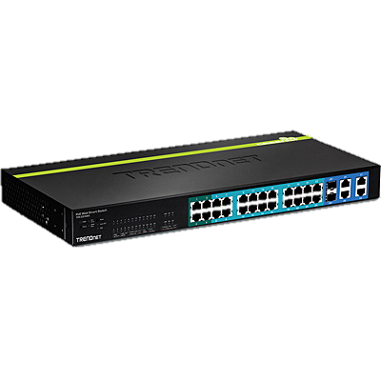
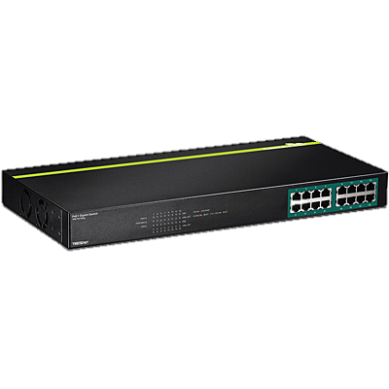
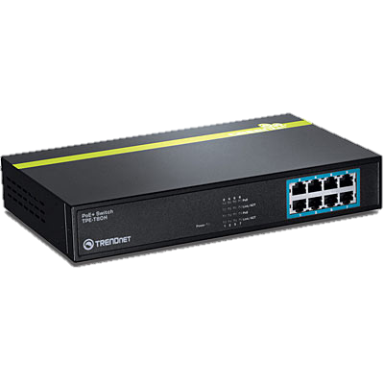
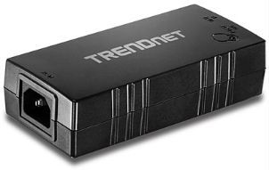
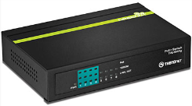
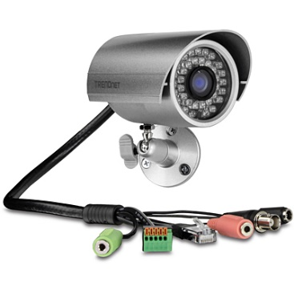

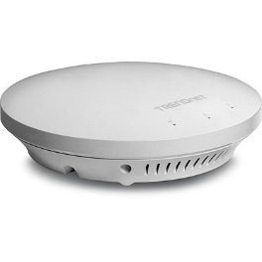
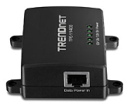
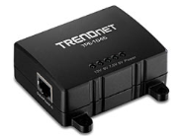

Introduction
The Three Elements of PoE
Power Sourcing Equipment (PSE)
Powered Device (PD)
Patch
TPE-115GI (Injector)
TPE-TG44G
TPE-T80H
TPE-TG160g
TPE-224WS
TEW-753DAP
TPE-114GS (Splitter)
TPE-104GS (Splitter)
TV-IP302PI
TV-IP450PI
TPE-1620WS

Slide 7
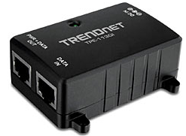
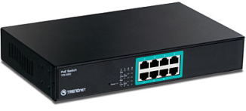
Introduction
Power Sourcing Equipment (PSE)
The PSE is connected to a device and at once detects whether the device falls into two categories. It's either a compliant device or it's non-compliant. If the device is compliant with the 802.3af or 802.3at standard then adequate power is supplied. If the device is non-compliant then power is not supplied.
These devices are designed to detect the power needed by providing a range of voltage from 37 up to 57 Volts to supply the necessary power levels to each device automatically.

Slide 8


Introduction
Powered Device (PD)
This is your VoIP Phone, camera, Wi-Fi access point or other devices. This will provide the correct impedance to the PSE and ideally send a signal to the PSE indicating how much power it requires.
Devices that are true 802.3af or 802.3at only need a single interface for power and data via the same network cabling.
Non-Compliant PoE can use a splitter to achieve that same advantages as standardized devices.

Slide 9
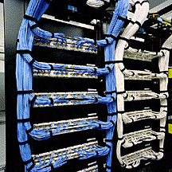
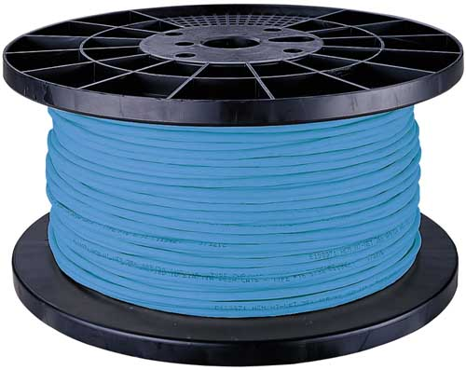

Introduction
Cabling
CAT 5 cable or better is used to transmit the power. The advantage is that this commonly used Ethernet cables can be used to keep installation costs down. The maximum length of cable is 100m (328ft) and the delivered power is 30w for PoE+ and 15.4w for standard PoE.

Slide 10
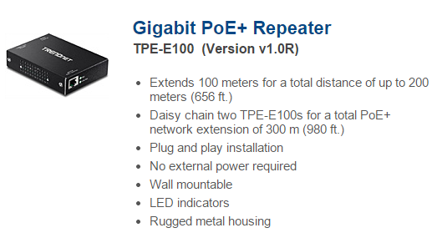
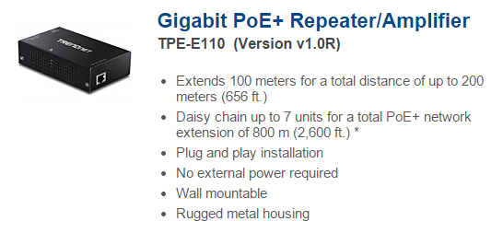
Introduction
Cabling – PoE+ Repeaters

Slide 11
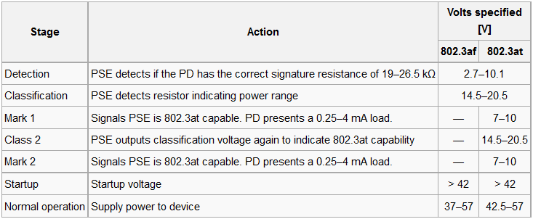
Introduction
PoE Power Up Stages

Slide 12


Introduction
Benefits
Cost Saving - reducing costs of new power outlets
Mobility - allows you a variety of setups without being tied down to a power outlet
Management – Ability to provide and control power output to specific devices.

Slide 13





PoE IP Cameras
Model | PoE Port | PoE Power Consumption | Features
TV-IP572(P/PI) | (1x) 10/100Mbps (802.3af) | 3.15W/4.95W | Megapixel/ H.264 572PI is IR
TV-IP612P | (1x) 10/100Mbps (802.3af) | 12W | Optical Zoom
TV-IP672(P/PI) | (1x) 10/100Mbps (802.3af) | 9W | PTZ/Megapixel 672PI is IR
TV-IP252P | (1x) 10/100Mbps (802.3af) | 8W | Fixed Dome
TV-IP262PI | (1x) 10/100Mbps (802.3af) | 7W | Megapixel/H.264

Slide 14




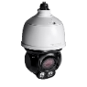

PoE IP Cameras
Model | PoE Port | PoE Power Consumption | Features
TV-IP311PI | (1x) 10/100Mbps (802.3af) | 5W | 3 Megapixel resolution ONVIF
TV-IP302P1 | (1x) 10/100Mbps (802.3af) | 6.24W | Wide angle Megapixel/H.264
TV-IP322P | (1x) 10/100Mbps (802.3af) | 9.5W | Narrow field of vision Megapixel/H.264
TV-IP310PI | (1x) 10/100Mbps (802.3af) | 5W | 3 Megapixel resolution ONVIF
TV-IP430PI | (1x) 10/100Mbps PoE + (802.3at) | 20W | 2 Megapixel/H.264 ONVIF v2.2
TV-IP450PI | (1x) 10/100Mbps PoE + (802.3at) | 35W | Megapixel/H.264 ONVIF v2.2

Slide 15
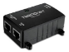

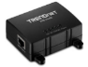
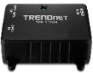
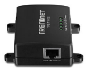
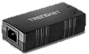
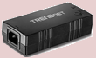
Splitters/Injectors
Model | Fast Ethernet | Gigabit | PoE Splitter Voltage/Wattage | PoE Injector Power Output
TPE-103I |  |  | N/A | 802.3af (mode A) Pins: 1, 2, 3, 6
TPE-104S |  |  | 5V, 7.5V, 9V, 12V | N/A
TPE-113GI |  |  | N/A | 802.3af (mode A) Pins: 1, 2, 3, 6
TPE-114GS |  |  | 5V, 7.5V, 9V, 12V | N/A
TPE-115GI |  |  | N/A | 802.3at (mode A) Pins: 1, 2, 3, 6
TPE-105I |  |  | N/A | 802.3at (mode A) Pins: 1, 2, 3, 6

Slide 16
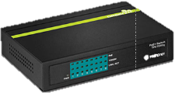
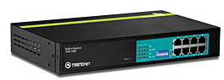
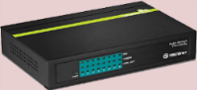
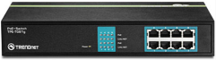
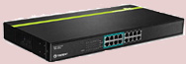
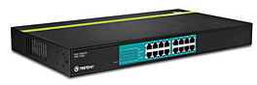
802.3at or PoE +
Model | Ports | IEEE PoE Standards | Total PoE Power Output | Unmanaged Plug & Play Design
TPE-TG44G | 4x (PoE/PoE+) 4x(Non-PoE) 10/100/1000Mbps | 802.3af 802.3at | 60 Watts (4x15w or 2x30w)
TPE-T80* | 8x (PoE/PoE+) 10/100Mbps | 802.3af 802.3at | 240 Watts (8x30w)
TPE-TG80G | 8x (PoE/PoE+) 10/100/1000Mbps | 802.3af 802.3at | 105 Watts (7x15w or 3x30w)
TPE-TG81G | 8x (PoE/PoE+) 10/100/1000Mbps Rackmount | 802.3af 802.3at | 105 Watts (7x15w or 3x30w)
TPE-T88G | 8x (PoE) 8x(Non-PoE) 10/100/1000Mbps | 802.3af 802.3at | 120W (8x 15w or 4x30w)
TPE-T160* | 16x (PoE/PoE+) 10/100Mbps | 802.3af 802.3at | 480W (16 x 30w)

Slide 17
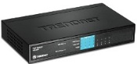
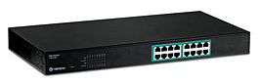
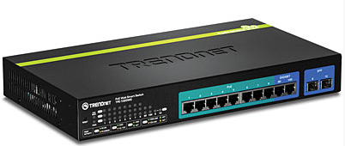
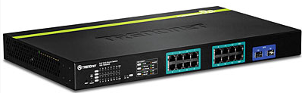
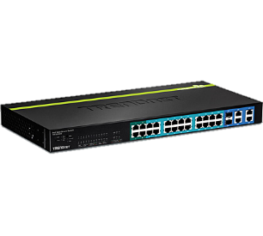
802.3af/at
Model | Ports | 10/100/100Mbps Ports | Total PoE Power Output | Web GUI Management
TPE-S44 | 4x (PoE/PoE+) 4x(Non-PoE) 10/100Mbps | NONE | 30W (Aggregate on 4 PoE Ports)
TPE-S80 | 8x (PoE) 10/100Mbps | NONE | 126W (8 x 15w)
TPE-S160 | 16x (PoE) 10/100Mbps | NONE | 254W (16 x 15w)
TPE-1020WS | 8x (PoE/PoE+) 2x(Non-PoE) 10/100/1000Mbps 2 SFP | 10x | 75W (Aggregate on 8 PoE Ports)
TPE-1620WS | 16x (PoE/PoE+) 10/100/1000Mbps 2 SFP | 16x | 185W (Aggregate on 16 PoE Ports
TPE-224WS | 24x (PoE) 4x (PoE+) 10/100Mbps 2 SFP 4x 1000Mbps | NONE | 193W (Aggregate on 24 PoE Ports)

Slide 18
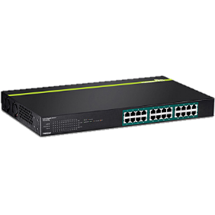
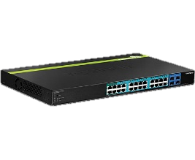
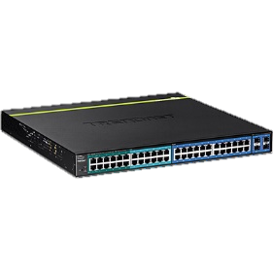
802.3af/at
Model | Ports | 10/100/100Mbps Ports | Total PoE Power Output | Web GUI Management
TPE-TG240g | 24x (PoE/PoE+) Gigabit | NONE | 370W
TPE-2840WS | 4x (PoE+) 20x (PoE) Gigabit 4 SFP | NONE | 185W
TPE-4840WS | 12x (PoE+) 12x (PoE) Gigabit 4 SFP Shared | 24x 1000Mbps | 370W

Slide 19
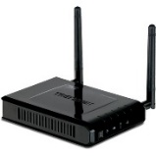



802.3af/at
Model | PoE Port | Speed | PoE Power Consumption | Features
TEW-638PAP | (1x) 10/100Mbps (802.3af) | N300 | 3.12w | 2 2dBi detachable antennas
TEW-753DAP | (1x) 10/100Mbps (802.3af) | N300 Per Band | 12w | Dual band 4dBi antenna VLAN tag support
TEW-735AP | (1x) 10/100Mbps (802.3af) | N300 | 6w | 2 4dBi Antennas Plenum rated VLAN tag support
TEW-653AP | (1x) 10/100Mbps (802.3af) | N300 | 6w | 4dBi Antenna VLAN tag support

Slide 20

PoE Power Budget
Total PoE power for entire switch
Some or all ports support PoE
Total power cannot exceeded budget

Slide 21

PoE Power Budget
Example – TPE-224WS
24 ports, 15.4W per port, 170W budget
If all PoE devices use 15.4W
170W / 15.4W = 11 PoE devices supported
Lower PoE requirement = more devices

Slide 22
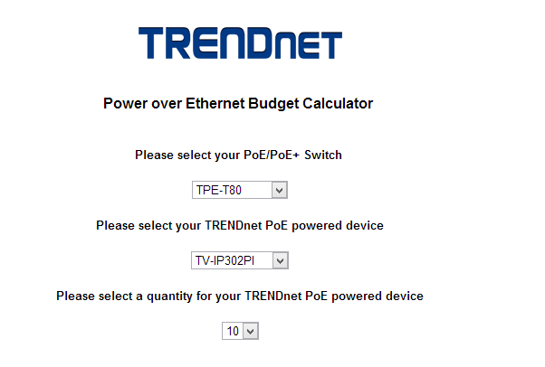

PoE Power Budget Calculator
Coming soon…

Slide 23
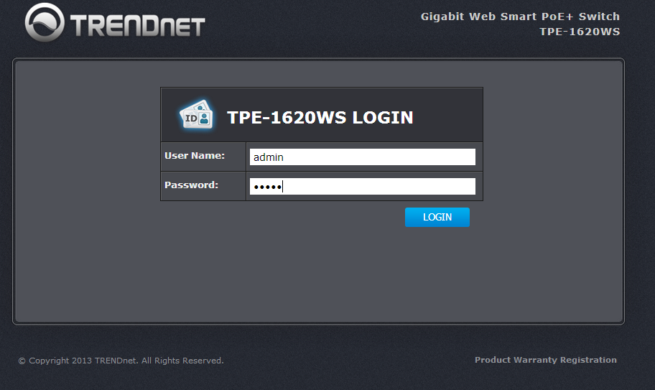
TPE-1620WS

Slide 24

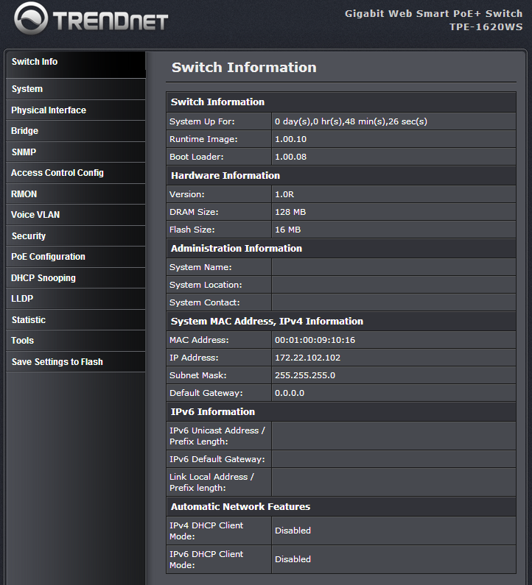
GUI

Slide 25
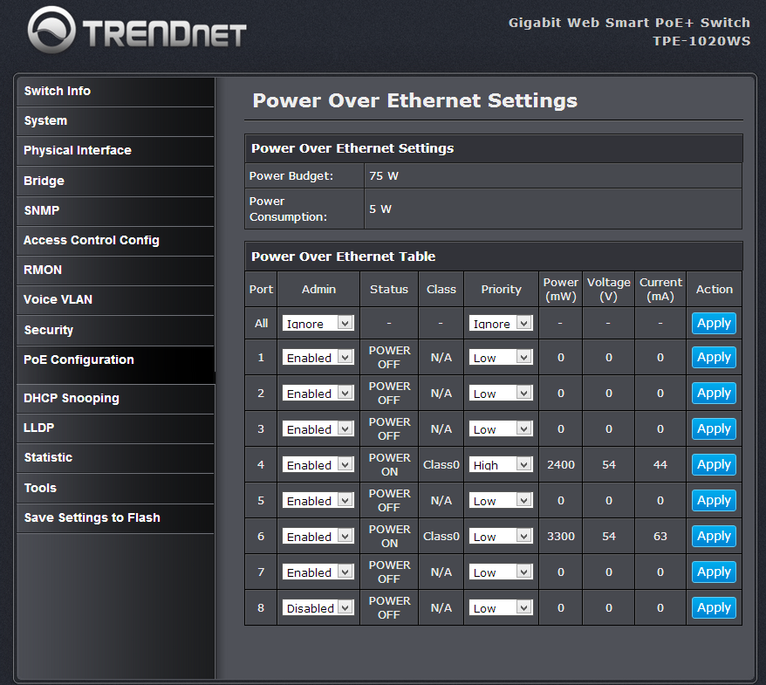


GUI
735 = 6W Max
672 = 9W Max

Slide 26

GUI

Slide 27
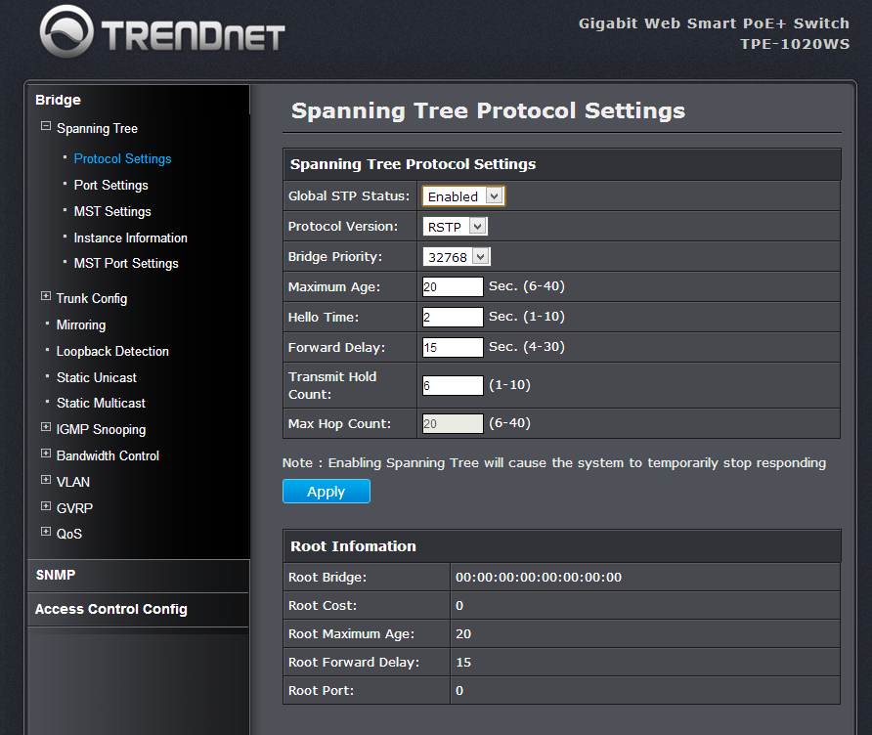
GUI

Slide 28
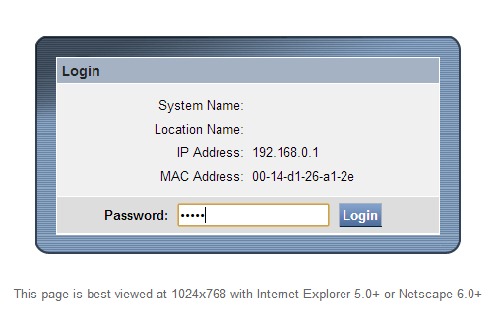
TPE-224WS

Slide 29
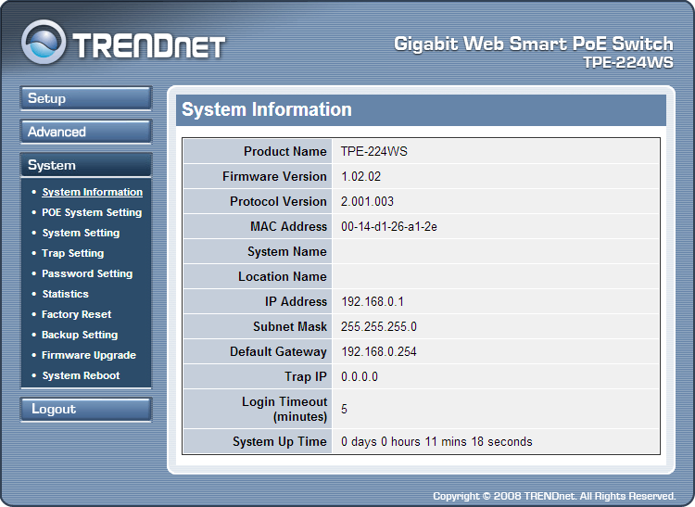
TPE-224WS
GUI

Slide 30
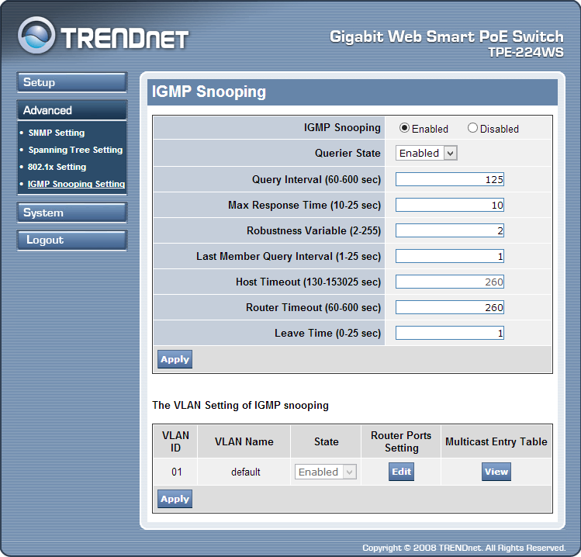
TPE-224WS
GUI

Slide 31
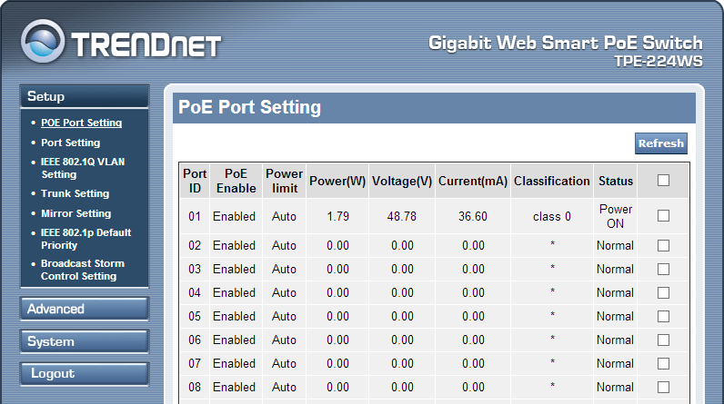
TPE-224WS
GUI

Slide 32

Applications
PoE Ethernet Switch
(TPE-224WS)
Wireless AP
(TEW-653AP)
Category 5e Cable
48V DC Power + Ethernet Data

Slide 33

Applications
PoE Switch with Power Splitter
PoE Ethernet Switch
(TPE-224WS)
Ethernet Data (Cat. 5e)
Category 5e Cable
PoE Power Splitter
(TPE-114GS)
Ethernet Device
(TEW-650AP)
7.5V DC Power
Ethernet Data (Cat. 5e)
12V DC Power
48V DC Power + Ethernet Data

Slide 34




Applications
Power Injector and Powered Device
Wireless AP HotSpot
(TEW-638PAP)
Ethernet Data (Cat. 5e)
PoE Power Injector
(TPE-113GI)
TEG-224WS
Category 5e Cable
48V DC Power + Ethernet Data
48V DC Power
Ethernet Data (Cat. 5e)

Slide 35



Applications
Power Injector and Power Splitter
Ethernet Data (Cat. 5e)
Internet Camera
(TV-IP551WI)
TEG-2248WS
PoE Power Injector
(TPE-113GI)
Category 5e Cable
PoE Power Splitter
(TPE-114GS)
48V DC Power
5V DC Power
5V DC Power
Ethernet Data (Cat. 5e)
48V DC Power + Ethernet Data

Slide 36
Advantage
Why TRENDnet?
High quality products
Award winning performance
20 years in the business
Advanced product feature sets
Price to performance leadership

Slide 37

Q&A
Questions?

Slide 38

Thank You

Slide 39
Agenda
01
Technology Overview
02
TRENDnet Product
03
TRENDnet Product
04
TRENDnet Product
05
TRENDnet Product
06
TRENDnet Product
07
Summary

Slide 40
Product Definition
Describe the product or service being marketed

Slide 41
Competition
The competitive landscape
Provide an overview of product competitors, and their strengths and weaknesses
Position each competitor’s product against the new product

Slide 42
Positioning
Positioning of product or service
Statement that distinctly defines the product in its market and against its competition over time
Consumer promise
Statement summarizing the benefit of the product or service to the consumer

Slide 43
Communication Strategies
Messaging by audience
Target consumer demographics

Slide 44
Packaging and Fulfillment
Product packaging
Discuss form factor, pricing, look, and strategy
Discuss fulfillment issues for items not shipped directly with the product
COGs
Summarize cost of goods and high-level bill of materials

Slide 45
Launch Strategies
Launch plan
If product is being announced
Promotion budget
Supply backup material with detailed budget information for review

Slide 46
Public Relations
Strategy and execution
PR strategies
PR plan highlights
Have backup PR plan including editorial calendars, speaking engagements, conference schedules, etc.

Slide 47
Advertising
Strategy and execution
Overview of strategy
Overview of media and timing
Overview of ad spending

Slide 48
Other Promotion
Direct marketing
Overview of strategy, vehicles, and timing
Overview of response targets, goals, and budget
Third-party marketing
Co-marketing arrangements with other companies
Marketing programs
Other promotional programs

Slide 49
Pricing
Pricing
Summarize specific pricing or pricing strategies
Compare to similar products
Policies
Summarize policy relevant to understanding key pricing issues

Slide 50
Distribution
Distribution strategy
Channels of distribution
Summarize channels of distribution
Distribution by channel
Show plan of what percent share of distribution will be contributed by each channel – a pie chart might be helpful

Slide 51
Vertical Markets/Segments
Vertical market opportunities
Discuss specific market segment opportunities
Address distribution strategies for those markets or segments
Address use of third-party partner role in distribution to vertical markets

Slide 52
International
International distribution
Address distribution strategies
Discuss issues specific to international distribution
International pricing strategy
Localization issues
Highlight requirements for local product variations

Slide 53
Success Metrics
First year goals
Additional year goals
Measures of success/failure
Requirements for success

Slide 54
Schedule
18-month schedule highlights
Timing
Isolate timing dependencies critical to success

